Slide 1



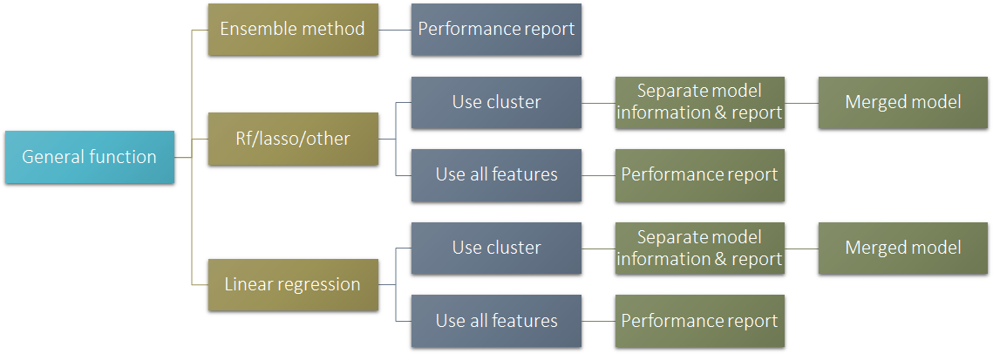
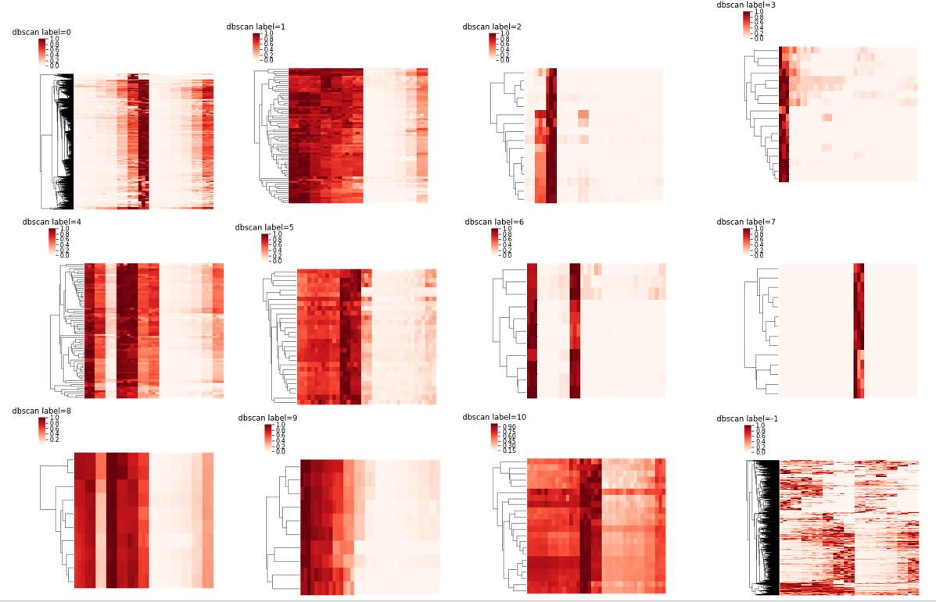
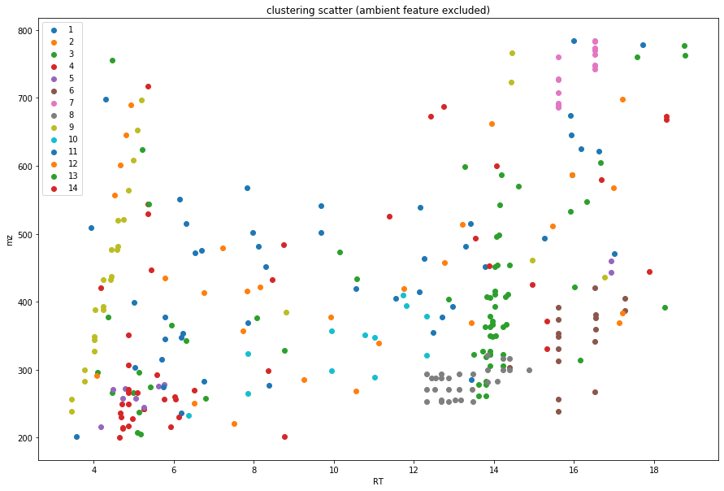
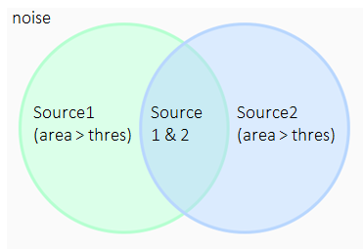
https://pypi.org/project/mass-suite/
Project Sponsor: Edward Kolodziej (University of Washington, Center of Urban water)
Project Team: Ximin Hu (Civil & Environmental Engineering), Derek Mar (Materials Science & Engineering),
Nozomi Suzuki (Materials Science & Engineering), Bowei Zhang (Materials Science & Engineering)
Project Overview
Mass-suite is a python based open source package that is designed to utilize High Resolution Mass Spectrometry (HRMS) data for water quality assessment. The analysis of HRMS data for water quality assessment is still in its infancy, with many basic aspects of data reduction, analysis, and interpretation still lightly developed. Here, our package will allow users flexible and various options to process the HRMS data: from basic functions to advanced data analysis, such as dilution rate prediction and source tracking analysis that is not currently covered with current software. Furthermore, it is developed in a modularized concept so that the user can use different combinations of parts of our code to accomplish their tasks. By providing this package, we hope to open up a new space for HRMS data analysis, resulting in more rapid and detailed research in this area.
Workflow
Overview
The goal of this project is to create a package which can be used to predict and track dilution levels of chemicals through Mass Spectrometry (MS)
Prior to modeling, the signals from MS are sorted, and aligned in order to create a cohesive database, with each unique chemical as a “feature” across different samples
Using this database, various models can be created to accomplish the goal of source and dilution tracking
Users have a choice in multiple steps: model selection, data selection, and visualziation
All choices come equipped with a report, enabling users to validate the accuracy of their resulting model
Dilution and Source Tracking
Once the chemicals are clustered, the dilution can be predicted by training a model based on example data
As shown in the workflow above, users can choose a best fitting model
Source identification is currently simplified based on dilution and intensity- it will be later expanded to take into account various modeling techniques
Clustering
Different chemicals’ intensity behaves differently across dilutions
This is called the Matrix Effect
We need to cluster chemicals into different groups to predict the dilution levels
We are able to see resulting clusters in the images above

Slide 2
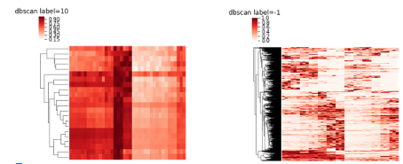
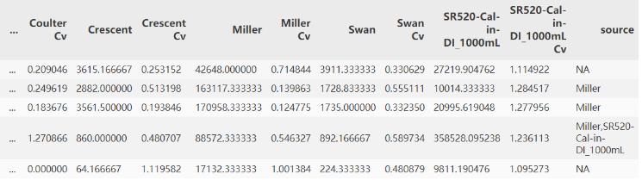
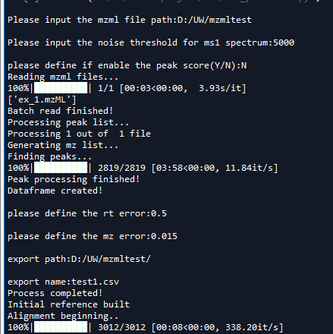
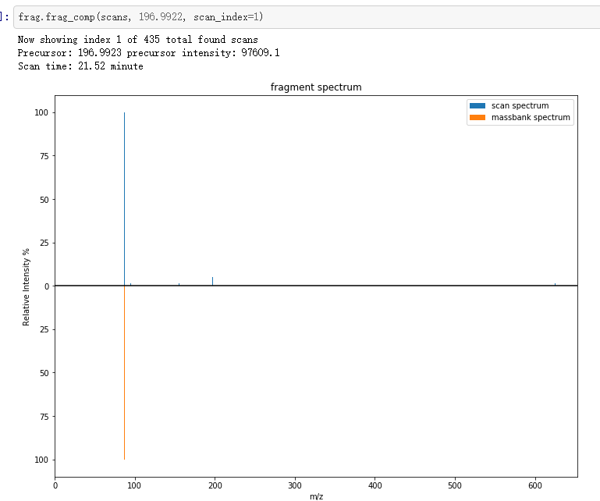
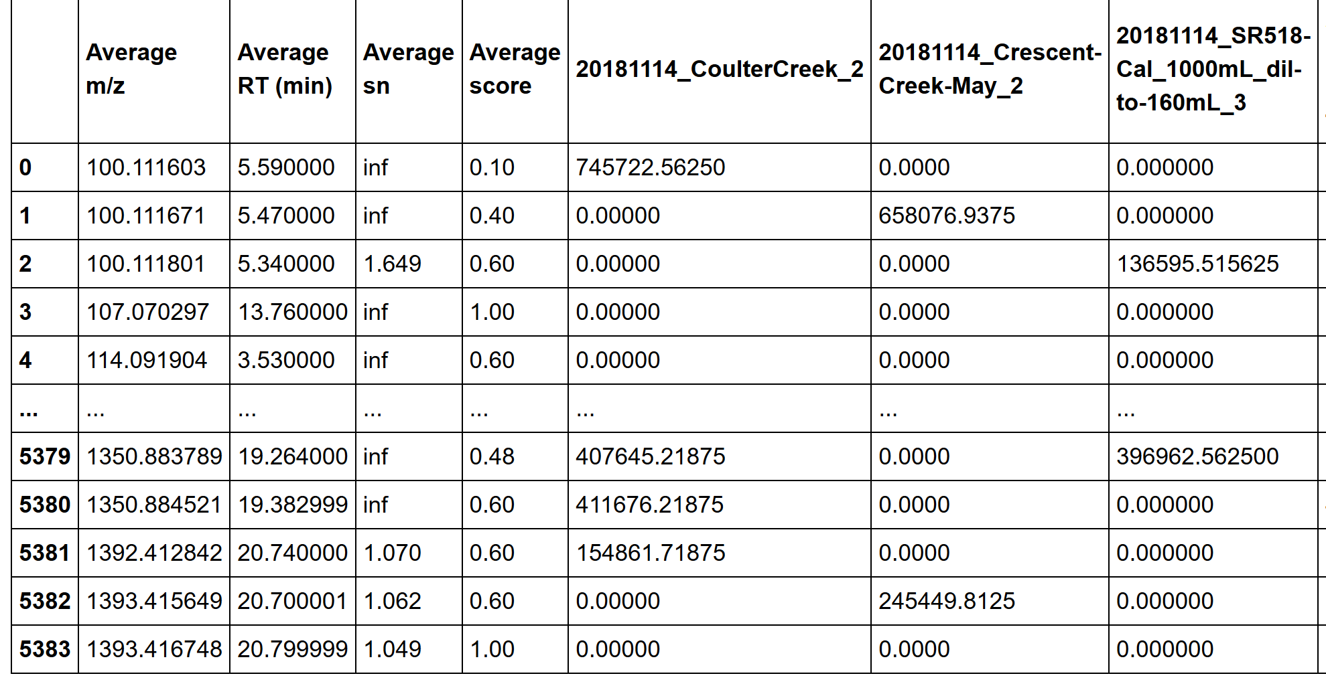
https://pypi.org/project/mass-suite/
Project Sponsor: Edward Kolodziej (University of Washington, Center of Urban water)
Project Team: Ximin Hu (Civil & Environmental Engineering), Derek Mar (Materials Science & Engineering),
Nozomi Suzuki (Materials Science & Engineering), Bowei Zhang (Materials Science & Engineering)
Project Background:
Mass-suite is a python based open source package that is designed to utilize High Resolution Mass Spectrometry (HRMS) data for water quality assessment. The analysis of HRMS data for water quality assessment is still in its infancy, with many basic aspects of data reduction, analysis, and interpretation still lightly developed. Here, our package will allow users flexible and various options to process the HRMS data: from basic functions to advanced data analysis, such as dilution rate prediction and source tracking analysis that is not currently covered with current software. Furthermore, it is developed in a modularized concept so that the user can use different combinations of parts of our code to accomplish their tasks. By providing this package, we hope to open up a new space for HRMS data analysis, resulting in more rapid and detailed research in this area.
Overview
Clustering:
Mass-Suite Features and Advantages:
Peak picking & alignment
Import data from .mzml file
HRMS data analysis – clustering &modeling
Clustering of different chemical features based on machine learning algorithms
Visualization & database searching
Detect and integrate peaks, assessing by trained model
Alignment across different samples
Noise removal, cluster labeling
Modeling & prediction based on dilution series samples
Quick source tracking tool
Basic plots for HRMS data
Interactive plot upon user selection
Online database search for advanced analysis
General:
First package on python which provide full workflow from data import to alignment result
Light memory usage make it possible to be run on personal laptops
Remote process option
Modularized setup – always possible for more
Open source – free to go!
Peak picking
Pymzml import enables faster speed
Peak score to enhance data quality
Alignment
High efficiency
Flexible settings for users
Data analysis
Visualization result for assess the analysis quality
Open end algorithm options to fit different needs
Handy function to boost up efficiency
Different chemicals’ intensity behaves differently across dilutions
This is called the Matrix Effect
We need to cluster chemicals into different groups to predict the dilution levels
We are able to see resulting clusters in the images above
Dilution Prediction and Source Tracking:
Key strength
Prior to modeling, the signals from MS are sorted, and aligned for data cleaning and clustering
Using the clustered data, models can be created to accomplish the goal of source and dilution tracking
Users have flexible options through out the whole workflow
Most of the analysis functions equipped with a result report for validation
Once the chemicals are clustered, the dilution can be predicted by training a model based on example data
As shown in the workflow above, users can choose a best fitting model
Source identification is currently simplified based on dilution and intensity- it will be later expanded to take into account various modeling techniques
Future Dev:
Example output:
Validation of Workflow using more data
Understanding chemical commonalities behind clusters
GUI and/or webtools for supporting non-technical users
Dynamically adapt and update program to fill growing needs
More..
Peak picking & alignment:
Contact Information:
github: https://github.com/XiminHu/mass-suite email:
xhu66@uw.edu
Acknowledgements:
A big shout to Professor Dave Beck, Professor Edward Kolodziej, Katherine Peter, and the Center of Urban Water for all their help during the development of this package.
Data Reference: Application of Nontarget High Resolution Mass Spectrometry Data to Quantitative Source Apportionment, Katherine T. Peter, Christopher Wu, Zhenyu Tian, and Edward P. Kolodziej, Environmental Science & Technology 2019 53 (21), 12257-12268, DOI: 10.1021/acs.est.9b04481

